Slide 1
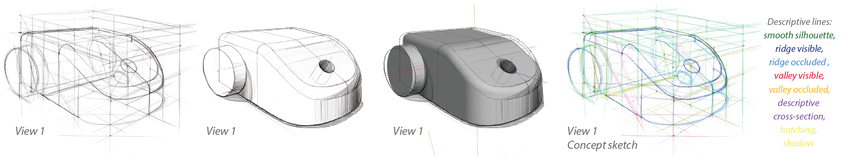
OpenSketch: A Richly-Annotated Dataset of Product Design Sketches
YULIA GRYADITSKAYA, Université Côte d’Azur, Inria
MARK SYPESTEYN, Delft University of Technology, Faculty of Industrial Design Engineering
JAN WILLEM HOFTIJZER, Delft University of Technology, Faculty of Industrial Design Engineering
SYLVIA PONT, Delft University of Technology, Perceptual Intelligence lab
FRÉDO DURAND, MIT CSAIL, Inria
ADRIEN BOUSSEAU, Université Côte d’Azur, Inria

Slide 2
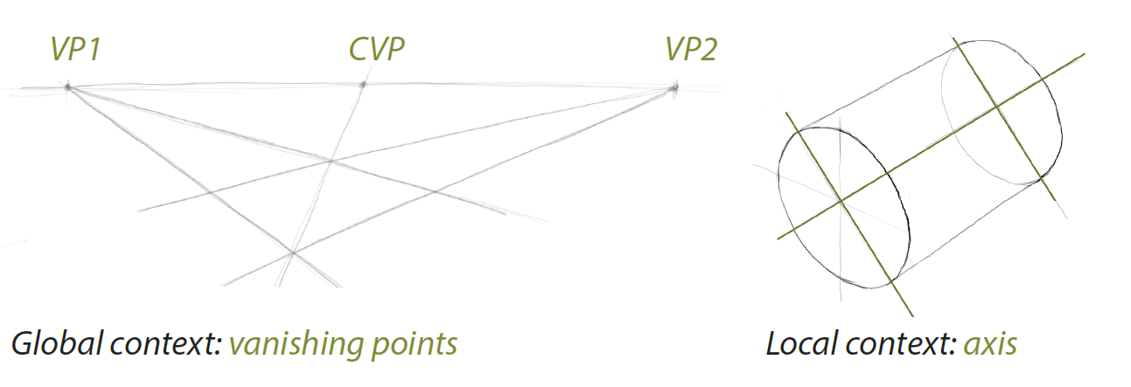
Construction Lines (context)

Slide 3
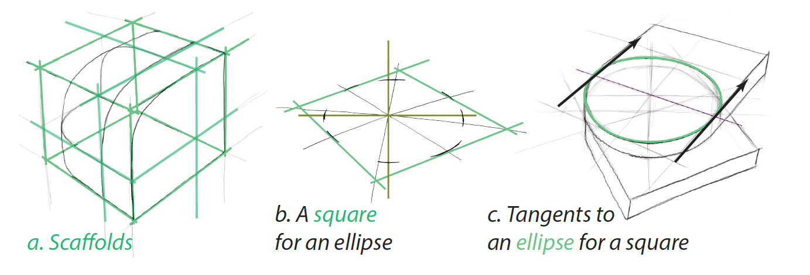
Construction Lines (scaffolds)

Slide 4
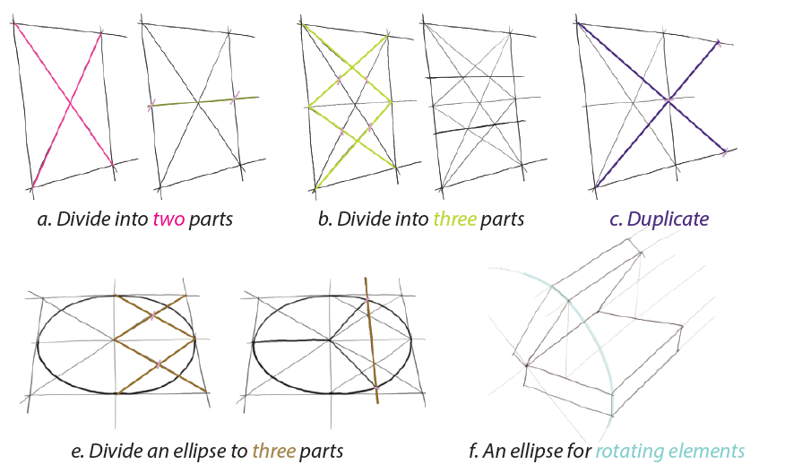
Construction Lines (proportions)

Slide 5
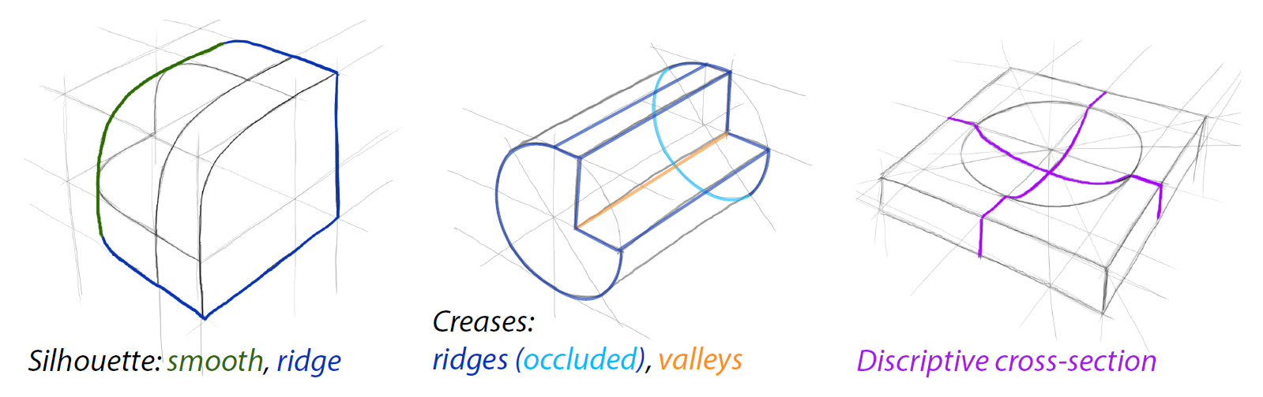
Descriptive Lines

Slide 6
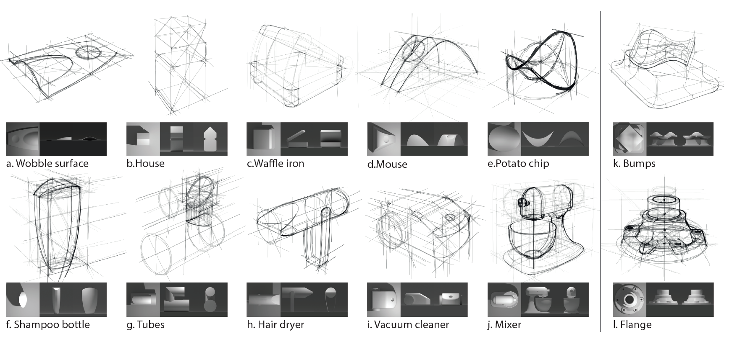
Data collection 12 shapes

Slide 7
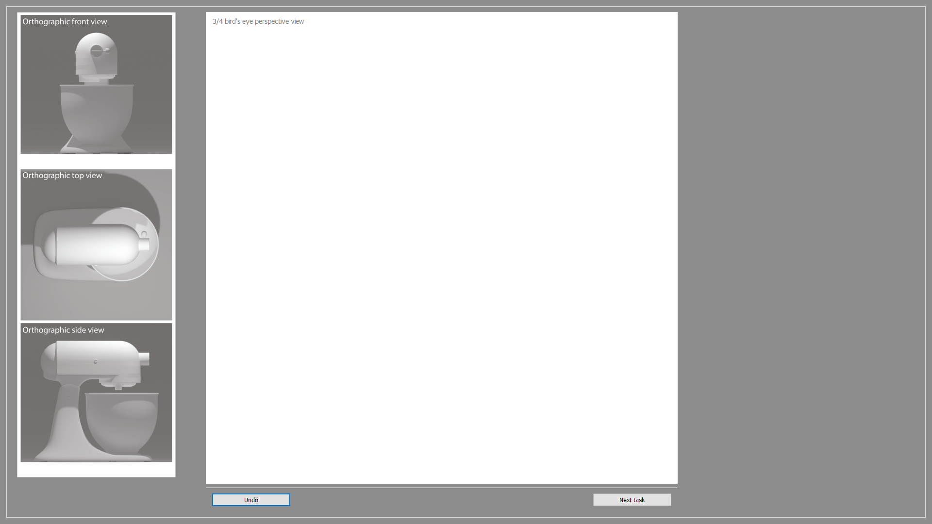
Data collection

Slide 8
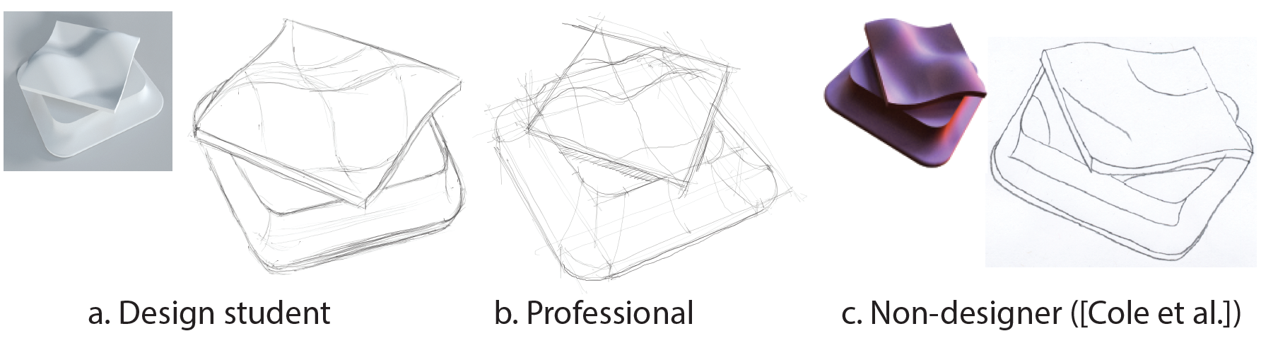
Data collection pilot study
When asked to draw an object from a reference view, design students and professionals tend to copy the lines they see, such as shading discontinuities (a,b). These lines resemble the ones drawn by non-designers in the study by Cole et al. [2008]

Slide 9
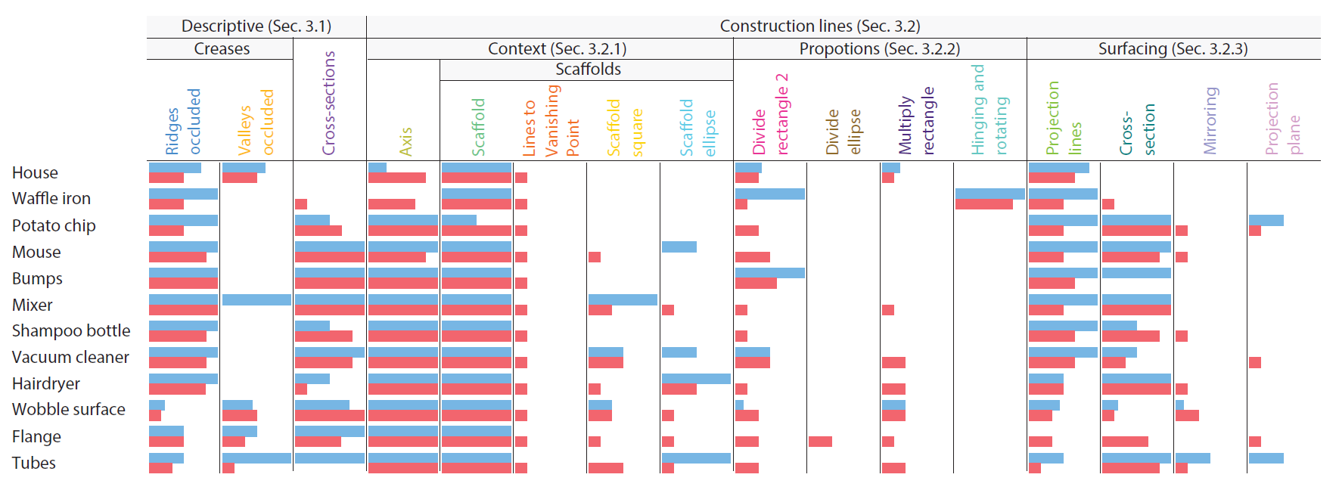
Distribution of Line Types
Distribution of line types (columns) usage over objects (rows). For each object and line type, the bars represent the percentage of drawings that contain at least one instance of that particular line type. Blue bars correspond to design students while red bars correspond to professionals.

Slide 10
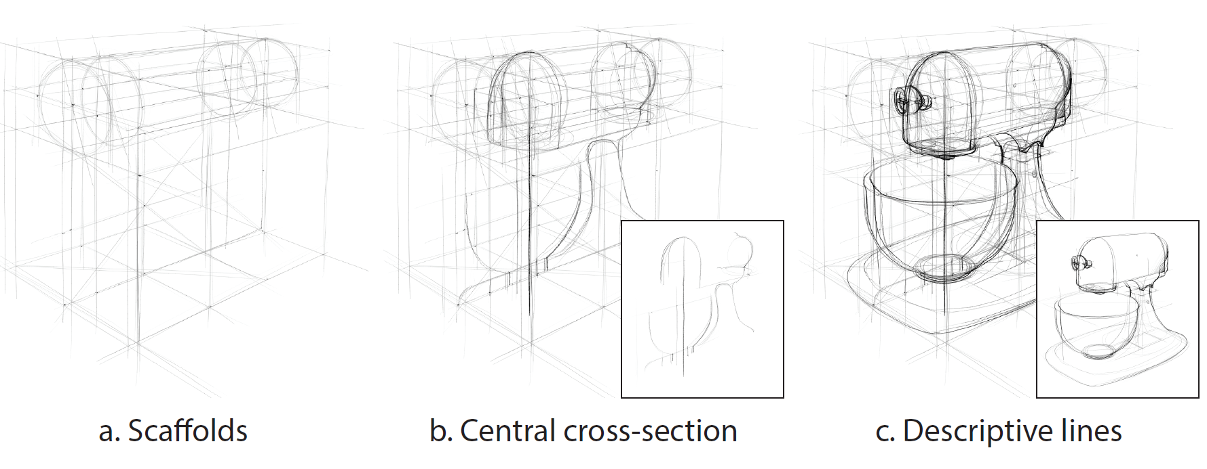
Typical sketch progress

Slide 11
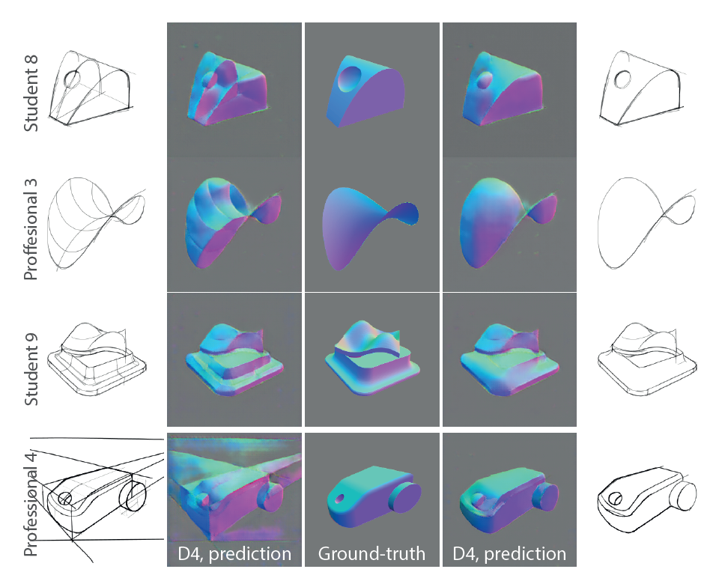
Applications: Normal Prediction
Authors demonstrate this application on Sketch2Normal [Su et al. 2018]

Slide 12
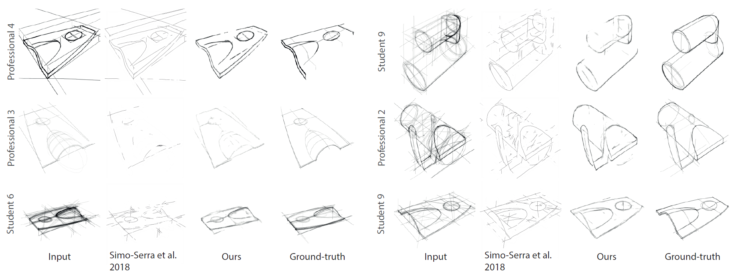
Applications: Sketch Filtering
Authors used the generic Pix2Pix image-to-image translation network for this task [Isola et al. 2017]

Slide 13
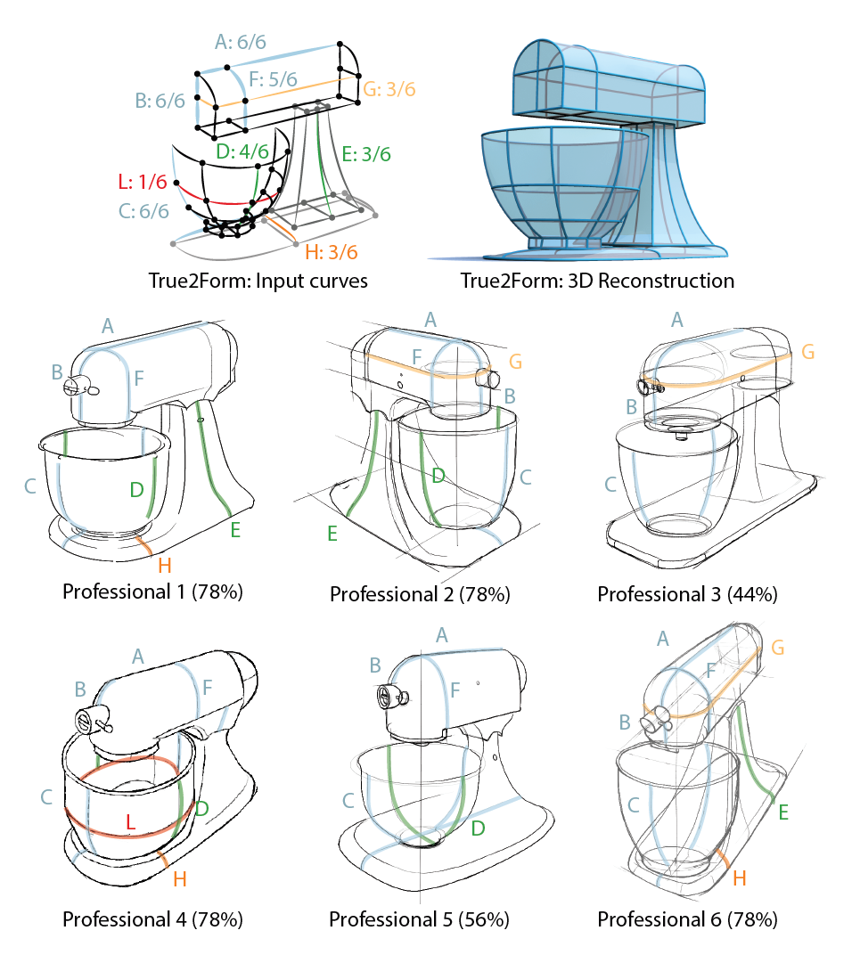
Evaluation of assumptions made by existing systems

Slide 14
Thank you

